Slide 1
Bipolar Transurethral Resection In Saline (TURis) And Vaporization
By
Hussein Shaher
MBBCH,Msc,MD
Lecturer of urology
Benha university

Slide 2
-Both the active and return poles are incorporated on the same electrode ,the energy does not travel through the body to reach a skin pad.
-Therefore, the energy remains confined at the site of prostate resection.
-Bipolar systems require less energy to complete the circuit because of less tissue and therefore less encountered resistance.
-its ability to function in a conductive fluid medium (normal saline) .

Slide 3
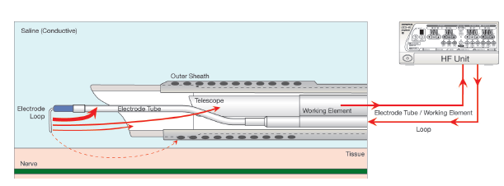

Slide 4
The PlasmaKinetic® (PK) system (Gyrus-ACMI, South-borough, MA) was the first true bipolar TURP system utilizing saline irrigant. The first generation was developed in the mid 1990s and consisted of a vaporizing electrode (PK V electrode). ( Boto et al., 2001).

Slide 5
What is Plasma?
-Plasma is one of the four fundamental states of matter and is created by applying energy to a gas.
-Molecules are ionized, thus turning the gas into a plasma. Due to its conductivity, the plasma allows the energy to cross at lower energy levels.
-The Plasma technology creates a controlled, stable plasma field to remove tissue at a low relative temperature, resulting in minimal thermal damage to surrounding soft tissues and a low penetration depth of energy.

Slide 6
Bipolar physics
-Energy gets transmitted from the loop electrode into the surrounding saline solution, The saline is vaporized into gas around the loop, with additional energy from the loop then converting the gas to plasma.
-The excited sodium ions of the plasma give this technology the characteristic orange glow (Plasma corona) that is called ignition.

Slide 7
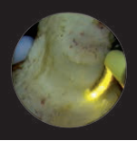
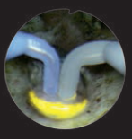
Once ignition occured the plasma molecules are able to be excited for use in resection or vaporization.
Resection loop vaporization loop

Slide 8
TURis
-There was no difference in the surgical technique between bipolar TURis and monopolar TURP.
-Isotonic 0.9% sodium chloride solution at room temperature is used as irrigant.
-Reduced risk of TUR syndrome.
-Minimized stimulation of obturator nerve.
-Extended operations times, Improved teaching options.

Slide 9
TURis
Early pooled results concluded that no differences exist in short-term urethral stricture/BNC rates, but B-TURP is preferable due to a more favourable peri-operative safety profile (elimination of TUR-syndrome; lower clot retention/blood transfusion rates; shorter irrigation, catheterization, and possibly hospitalization times). Subsequent meta-analyses supported these conclusions.
(EUA guidelines 2019)

Slide 10
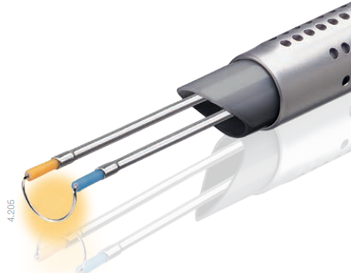
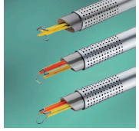
Olympus resection loop Storz resection loop

Slide 11
Plasma Vaporization
-Plasma vaporization requires a bipolar high frequency generator for sufficient plasma activation.
-Plasma vaporization of the prostate is performed under direct visualisation using the electrode in a near-contact technique (Hovering technique).

Slide 12
Plasma Vaporization
-Plasma vaporization enables continuous and safe
hemostasis.
-Short learning curve and fast and easy set-up, just as
simple as standard resection.
-Clear and unobstructed view throughout the operation as neither tissue chips nor major bleeders.
-The Plasma loop leads to a smooth operative tissue surface

Slide 13
Plasma Vaporization
-Early pooled results concluded that no statistically significant differences exist collectively for intra-operative and short-term complications between plasmakinetic B-TUVP and TURP but peri-operative complications are significantly fewer after B-TUVP.
-Subsequent RCTs suggest a better haemostatic efficiency for B-TUVP, resulting in shorter catheterisation and hospitalisation times.(EUA guidelines 2019)

Slide 14
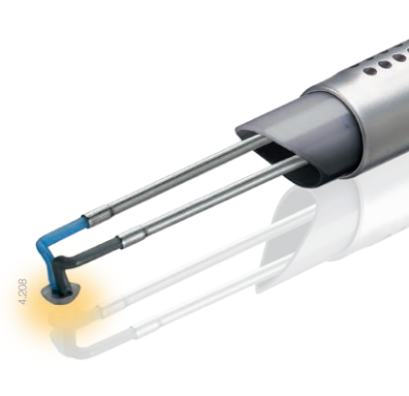
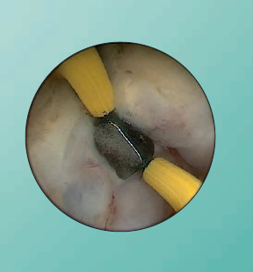
Vaporization loop
Olympus plasma button Storz

Slide 15
Advantages of the Plasma Vaporization
-Reduced risk of TUR syndrome.
-Less obturator nerve stimulation.
-Lower blood transfusion rate due to good hemostasis and less bleeding.
-Efficient in patient on anticoagulant medications.
-Shorter hospital stay ·
-Shorter catheterization time.

Slide 16
THANK YOU

