Slide 1
بسم الله الرحمن الرحيم

Slide 2
Describe the conventional surgical options for BPH:
Indications
Choice of surgery
outcome

Slide 3
General indications of surgical treatment:
Relative indication:
Patients have not obtained adequate relief from LUTS or PVR using conservative or medical treatments.
Absolute indications:
Refractory urinary retention,
Overflow incontinence,
Recurrent UTIs,
Bladder stones or diverticula,
Treatment-resistant macroscopic haematuria due to BPH, or
Dilatation of the upper urinary tract due to BPH, with or without renal insufficiency.

Slide 4
Modalities of surgical treatment:
Minimally Invasive treatment:
Intraprostatic Stents
Prostatic urethral lift
Transurethral Needle Ablation of the Prostate
Transurethral Microwave Therapy
Transurethral Incision of the Prostate
Laser prostatectomy
Holmium laser enucleation and holmium laser resection of the prostate
Greenlight laser vaporisation of prostate
Diode laser vaporisation of the prostate
Thulium:yttrium-aluminium-garnet laser (Tm:YAG)
Transurethral Resection of the Prostate
Open Prostatectomy

Slide 5
The choice of surgical technique depends on
Prostate size,
Comorbidities of the patient,
Ability to have anaesthesia,
Patients’ preferences,
Willingness to accept surgery-associated specific side-effects,
Availability of the surgical facilities,
Experience of the surgeon with these surgical techniques.

Slide 6
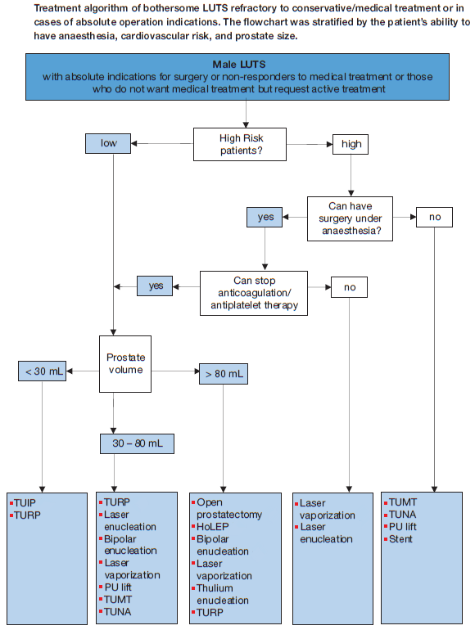
Algorithm for surgical approaches:

Slide 7
Outcome of different modalities:
Efficacy
Qmax improvement
Reduction in IPSS
QoL score
PVR
Need for second prostatic operation
Complications
TUR-syndrome
Bleeding requiring transfusion
clot retention
Long-term complications comprise
Urinary incontinence,
bladder neck contracture (BNC),
urethral stricture,
retrograde ejaculation
ED

Slide 8
Transurethral resection of the prostate and transurethral incision of the prostate
Efficacy:
Qmax improvement,
Significant reduction in IPSS,
Improve QoL score, and
Decrease PVR
Re-operation was more common after TUIP (18.4%) than after TURP (7.2%).

Slide 9
Complications
The risk of TUR-syndrome decreased to < 1.1% .
No case has been recorded after TUIP.
Bleeding requiring transfusion in 2.9% .
The risk after TUIP is negligible.
Clot retention:
more in TURP and
Long-term complications:
Urinary incontinence (1.8% after TUIP vs. 2.2% after TURP),
bladder neck contracture (BNC) (4.7% after TURP),
urethral stricture (3.8% after TURP vs. 4.1% after TUIP),
retrograde ejaculation (65.4% after TURP vs. 18.2% after TUIP), and
ED (6.5% after TURP).

Slide 10
Bipolar TURP
Efficacy:
No clinically relevant differences exist in efficacy.
Complications:
B-TURP is preferable due to a more favourable peri operative safety profile:
elimination of TUR-syndrome;
lower clot retention rates;
lower blood transfusion rates
Shorter irrigation, catheterisation,and hospitalisation times
Higher stricture (urethral stricture+BNC) rate
Similar effect on erectile function.

Slide 11
Open prostatectomy
Efficacy:
reduces LUTS by 63-86% ,
improves QoL score by 60-87%,
increases mean Qmax by 75%, and
reduces PVR by 86-98%.
Complication
The estimated transfusion rate is about 7-14%.
Long-term complications include:
Transient urinary incontinence (up to 10%),
BNC and urethral stricture (about 6%).
Holmium laser enucleation of the prostate (HoLEP) lead to similar outcomes compared to OP in men with large glands at a significantly lower complication rate.

Slide 12
Transurethral microwave therapy (TUMT)
Efficacy:
TUMT has comparable effect with TURP in improving:
Symptom score
Qmax
TUMT patients were more likely than TURP patients to require retreatment for symptoms.
Complications:
TURP is better than TUMT in:
Less catheterisation time,
Less dysuria/urgency and
Less Urinary retention rates
More effective in median lobe enlargement
More durabie
TUMT is better than TURP in:
Less hospitalisation time,
haematuria,
clot retention,
transfusion,
TUR-syndrome,
sexual dysfunction

Slide 13
Transurethral needle ablation of the prostate
Efficacy:
TUNA™ significantly improved IPSS and Qmax, but compared to TURP these improvements were significantly lower at 12 months.
The overall re-treatment rate after TUNA™ is considerably higher than that seen with TURP.
Complication:
Generally, TUNA™ is associated with fewer adverse events compared to TURP, including
mild haematuria,
urinary infections,
strictures,
incontinence,
ED, and
ejaculation disorders.

