Slide 1
Journal Club urology department benha university
2019

Slide 2
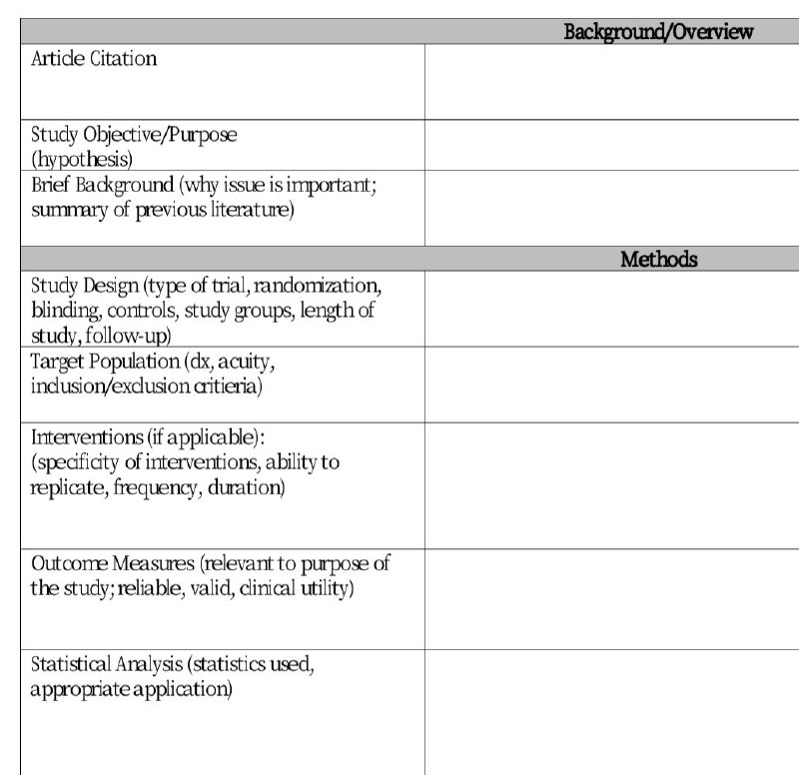

Slide 3
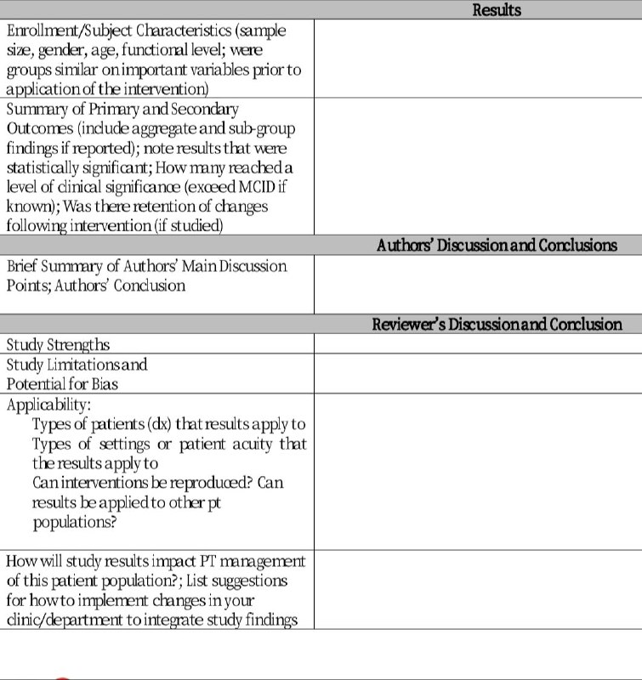

Slide 4
Buccal mucosal graft versus penile skin flap urethroplasty
for long segment penile urethral stricture: a prospective
randomized study

Slide 5
ARTICLE CITATION
Citation: Ali AI, Hamid AA, Abdel-Rassoul MA, et al. Buccal mucosal graft versus penile skin flap urethroplasty for long segment penile urethral stricture: a prospective randomized study. Cent European J Urol. 2019; 72: 191-197.

Slide 6
Study objective
To analyze the outcomes of dorsolateral onlay buccal mucosal graft (BMG) and ventral onlay local penile skin flap (LPF) urethroplasty in the management of long segment penile urethral strictures.

Slide 7
Brief background
(summary of previous literature)

Slide 8
Study design
a prospective randomized study

Slide 9
Target population (Inclusion and exclusion critieria)
Long segment penile urethral stricture was defined as a stricture with a length of more than 1 cm with spongiofibrosis and/or previous failed urethral dilatation, direct vision internal urethrotomy (DVIU) or urethroplasty.
Exclusion critieria
Patients with lichen sclerosus and those with history of hypospadias repair were excluded from our study.

Slide 10
Patients and methods
A total of 84 patients with long segment penile urethral stricture were randomly assigned to receive either dorsolateral onlay buccal mucosal graft urethroplasty (42 patients) or ventral onlay local penile skin flap urethroplasty (42 patients).

Slide 11
SURGICAL TECHNIQUE
For local penile flap urethroplasty, the urethra does not have to be mobilized off the corporal bodies. A 22 or 24 Fr bougie is inserted to detect the distal end of the stricture, then a ventral urethrotomy incision is performed onto the bougie.
The urethrotomy is continued with tenotomy scissor proximally throughout the strictured segment including 1 to 2 cm both proximally and distally through the healthy urethral lumen, so that a 26–30 Fr bougie is accepted in both directions, then the length of the defect is measured.

Slide 12
Three types of urethral flaps were used depending on the location and length of the stricture. The longitudinal (Orandi) flaps, McAninch (circular) flaps or the (Q) flaps. A Foley catheter is left in place and a gentle pressure dressing is applied.

Slide 13
For Buccal mucosal graft urethroplasty surgical technique, the urethra does not have to be mobilized off both corporal bodies in dorsolateral onlay
technique, but we do dissect the corpus spongiosum free on one side to the dorsal midline attachments.
The urethrotomy incision is done dorsolaterally, and then urethrotomy is continued with tenotomy scissors proximally and distally through the stricture and for at least 1 cm into healthy urethra in both directions, a 26–30 Fr bougie is inserted in both directions, then the length of the defect is measured.

Slide 14
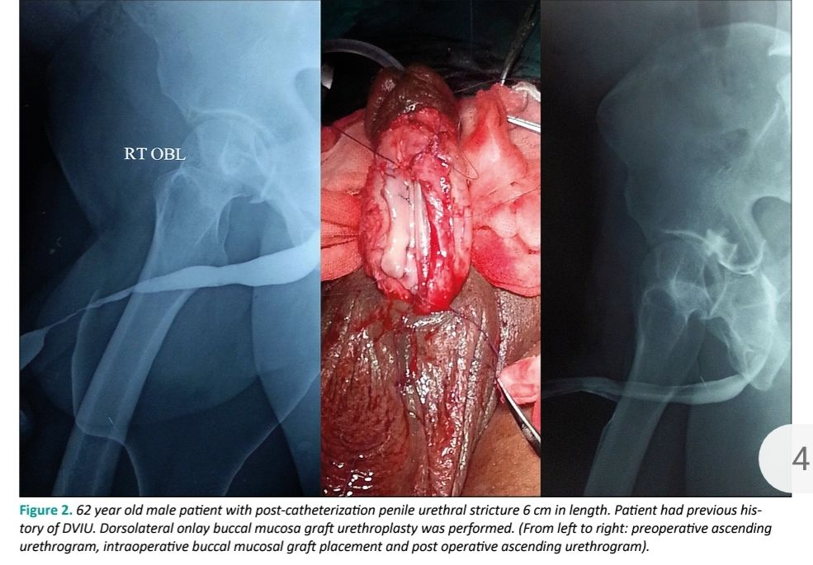

Slide 15
After that, the oral mucosa is harvested. The width of the graft is around 15–20 mm. Graft defatting is done carefully to remove the underlying tissue. If needed, another graft may be harvested from the other cheek using the same technique.
The graft is fixed to the corpora cavernosa and several quilting sutures are added to it. Small incisions along the graft are made to prevent hematoma or edema formation.

Slide 16
After introduction of a 16 Fr silicone catheter, the edges of the stricturotomy are then sutured to the graft, as well as to the corpora cavernosa using 4-0 vicryl sutures, and a gentle pressure dressing is applied. Operative time was documented in all patients .
The patients were ambulatory on the first postoperative day and discharged on the first or second postoperative day. After four weeks of surgery, pericatheter urethrography was done and the catheter was removed if no extravasation detected. Patients with wound infection at the level of suture line had extended catheterization for 1 or 2 more weeks.

Slide 17
Uroflowmetry, retrograde urethrography and micturating cysto¬urethrography were done after 3 and 6 months, or earlier if obstructive symptoms arose. The follow-up thereafter included symptomatic assessment and uroflowmetry every 6 months.
Urethrography was performed only if symptoms or uroflowmetry suggested recurrent stricture. The criteria for successful reconstruction were peak flow rate >15 ml/sec and no postoperative requirement of any kind of instrumentation.

Slide 18
Statistical analysis (statistics used , )
Data management and analysis were performed using SPSS program; version 21

Slide 19
Outcome measures
(relevant to purpose of study , reliable , valid , clinical utility)

Slide 20
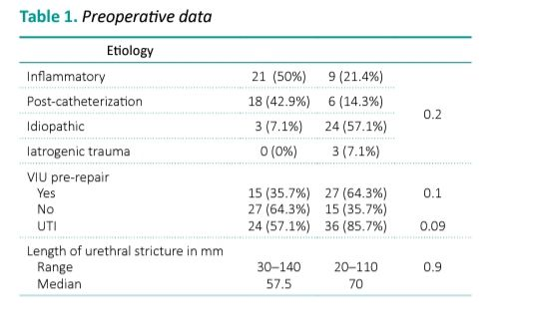

Slide 21
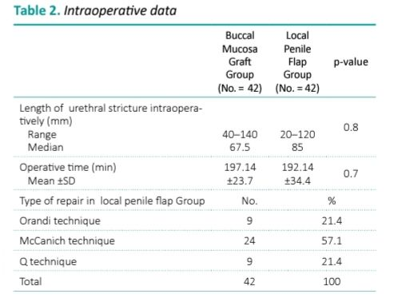

Slide 22
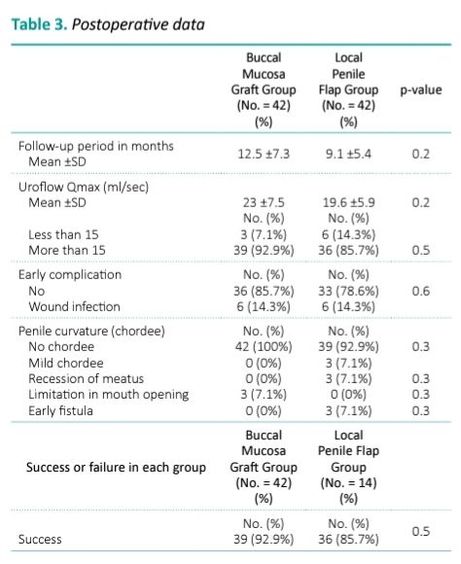

Slide 23
Discussion
All reconstructive urologists are aware that there is a difference in surgical steps, possible complications and results between penile urethroplasty and
bulbar urethroplasty using one stage flap or graft techniques. It is also well known that the etiology and length of the stricture affect the results of urethroplasty procedures.

Slide 24
When the stricture length was detected intraoperatively, we found a discrepancy in stricture length varying between 10 to 20%. The reason for this discrepancy is that we had to open the urethra at the site of stricture until we reached healthy urethral tissue on both ends.
Given the previous observation, we believe that intraoperative assessment is the most reliable method for assessing the length of urethral stricture.

Slide 25
In the present study, the success rate in the BMG group was 92.9%, three patients in this group developed a small urethral stricture, one of them with
preoperative urethral stricture length of 10 cm developed a small urethral stricture at the site of proximal anastomosis in the 8th month after surgery.

Slide 26
In the present study, three different types of local penile flaps were used depending on location and length of the stricture. The heterogenous usage of penile flaps in urethral reconstruction may have led to higher success rates and better outcomes in our results compared to Guido Barbagli and colleagues who used only one type of flaps [12].

Slide 27
In our study, the mean peak flow rate was 23 ±7.5 ml/s in the BMG group, which was higher than that of the LPF group (19.6 ±5.9 ml/s), however this difference was statistically insignificant (p = 0.2).

Slide 28
In our study, peri-catheter urethrography was performed in all patients after 4 weeks of surgery. Two patients in the BMG group and one patient in
the LPF group developed wound infection with increased risk of wound dehiscence. In these patients the catheters were left in place for an extra week. In our opinion, the main reason of normal pericatheter urethrography with no incidence of extravasation detected in any of our cases is related
to the longer duration of catheterization

Slide 29
Regarding postoperative complications, Dubey et al. in their prospective study on 55 patients with anterior urethral strictures who had either BMG
(27 patients) or LPF (28 patients) urethroplasty, reported that 2 patients in each group had postoperative hematoma and one patient in the LPF group
had wound infection.
In the LPF group, 6 patients developed superficial penile skin necrosis that healed within 6 weeks postoperatively.

Slide 30
One patient developed extensive skin loss managed by split skin grafting. Two patients in the LPF group and one patient in the BMG group had mild extravasation of dye on VCUG at 3 weeks after surgery.

Slide 31
Two patients in the LPF group developed slight penile torsion that did not interfere with sexual intercourse. In the BMG group, six patients (25.7%) complained of minor oral morbidity that was resolved after 4 weeks postoperatively.
Four patients developed perioral numbness at the early postoperative period. One patient developed a mucus retention cyst which resolved spontaneously [9].

Slide 32
In our study, six patients (14.3%) in each group developed wound infection that was managed by frequent dressing and antibiotics according to wound
swab culture and sensitivity.
In the LPF group, three patients (7.1%) developed small distal penile fistula, and another three patients (7.1%) developed mild chordee (penile curvature) postoperatively.
For all patients with postoperative penile curvature, no surgical intervention was performed. No patient in the buccal mucosal graft group developed penile curvature.

Slide 33
In the LPF group, three patients (7.1%) had recession of the meatus ending in subcoronal position of the meatus; they were offered correction, but
they refused ensuring that they are satisfied with this outcome.
In the BMG group, all of our patients had mild pain at the donor site that was self-limited. Three patients had mild limitation of mouth opening that
improved with time.

Slide 34
On an intermediate term of follow-up, dorsolateral onlay buccal mucosal graft and ventral onlay penile skin flap have similar success rates in penile urethroplasty, with essentially comparable postoperative morbidity.
In our study we also concluded that intraoperative assessment of urethral stricture length is more accurate than preoperative assessment performed
by retrograde urethrogram and we recommend that reconstructive urologists should have enough experience and different tools to deal with any intraoperative surprises.

Slide 35
Thank you

